Slide 1
Image Classification using Tensorflow

Slide 2
Applications of Machine Learning
Classification (Is it a dog or a cat?)
Prediction (Stocks/ Weather)
Clustering (Create groups with similarities)
Image/ Speech Recognition
Association Rules (MBA)
Medical and Healthcare
Robotics

Slide 3
What is Image Classification
Image classification is the task of classifying an image into a class category. It is the most well-known computer vision task.
Famous examples of Image classification include:
MNIST
ImageNet
Cifar-10

Slide 4
Machine Learning Approach (CNN)
Convolutional Neural Network (ConvNets or CNNs)
Image recognition, image classification, Object detection, recognize faces etc., are some of the areas where CNNs are widely used.
CNN image classifications takes an input image, process it and classify it under certain categories (Eg., Dog, Cat, Tiger, Lion).

Slide 5
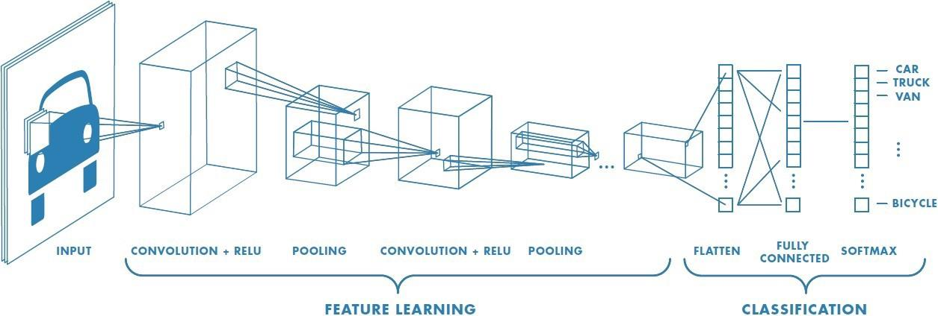
Convolution Neural Networks

Slide 6
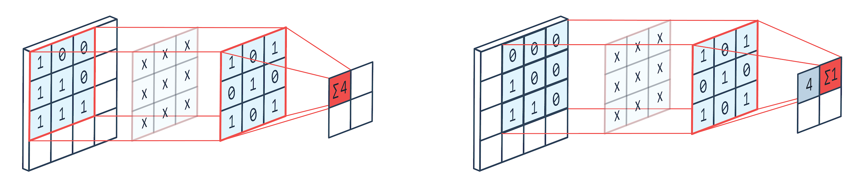

Slide 7
Tensorflow
TensorFlow is a free and open-source library widely used for Machine Learning.
It is a low-level API that provides flexibility to neural networks
Keras, a higher-level API runs on top on TensorFlow and provides an easy to work with interface to TensorFlow.

Slide 8
What is ANN ?
Artificial Neural Networks
Computer programs/models capable of performing human brain-like activity (neural system)
Layers of Artificial Neurons connected in a manner to interpret data

Slide 9
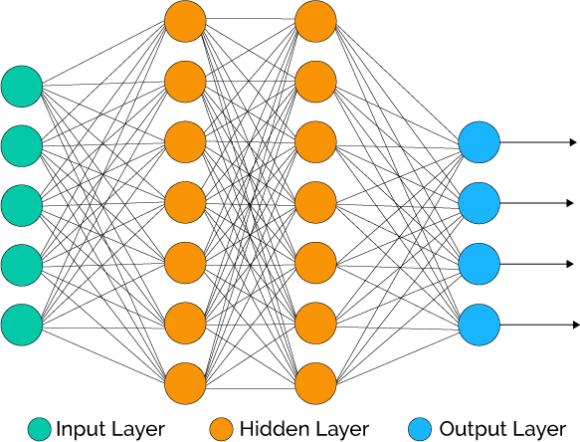
Artificial Neural Networks:

Slide 10
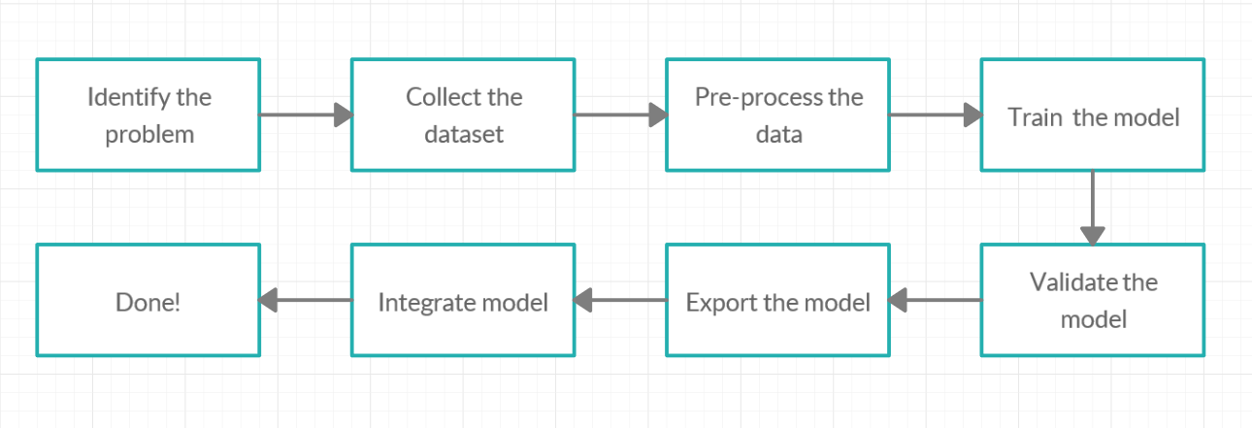
How to build a machine learning application:

